Slide 1
Text Recognition From Lip Movement
Bharath Kumar R - 2016103017
Hari Krishnan S - 2016103527
Silambarasan J - 2016103592

Slide 2
INTRODUCTION
Lipreading is a visual-communication technique which allows you to “listen” to a speaker by watching the speaker’s face to figure out their speech.
It plays a vital role in human communication and speech understanding, especially for hearing impaired individuals
Automated lipreading approaches have recently been used in such applications as biometric identification, silent dictation, forensic analysis of surveillance camera capture, and communication with autonomous vehicles.

Slide 3
OVERALL OBJECTIVE
The goal of Lip-reading is to decode and analyze the lip movements of a speaker for a said word or phrase with aid of deep neural networks for maximum efficiency.

Slide 4
LITERATURE SURVEY
“Continuous Optical Automatic Speech Recognition by Lipreading” Alan J. Goldschen, Oscar N. Garciay, Eric Peta jan
They describe a continuous optical automatic speech recognizer (OASR) that uses optical information from the oral-cavity shadow of a speaker.
The system achieves a 25.3 percent recognition on sentences having a perplexity of 150 without using any syntactic, semantic, acoustic, or contextual guides.
They introduce 13, mostly dynamic, oral-cavity features used for optical recognition, present phones that appear optical ly similar (visemes) for our speaker, and present the recognition results for our Hidden Markov Models (HMMs) using visemes, trisemes, and generalized trisemes.

Slide 5
"Text Recognition from Silent Lip Movement Video." (2018) - Youda Wei, Xiaodong Hu.
In this paper, he proposed two network architectures lip reading task.
First, the visual to audio feature architecture maps a variable-length sequence of video frames to the auditory MFCC features.
Second, the audio feature to text architecture distinguishes the text information from the audio feature.
The experiments showed that such a combination improves both quality and accuracy in real life situation. The result of the validation accuracy is 92.76%

Slide 6
"LIP2AUDSPEC: SPEECH RECONSTRUCTION FROM SILENT LIP MOVEMENTS VIDEO." (2018) - Hassan Akbari, Himani Arora, Liangliang Cao, Nima Mesgarani.
Here they used auditory spectrogram as spectral representation of speech and its corresponding sound generation method resulting in a more natural sounding reconstructed speech.
They have proposed a structure consisting of an autoencoder to extract bottleneck features from the auditory spectrogram which is then used as target to our main lip reading network comprising of CNN, LSTM and fully connected layers.
They showed that such a combination improves both quality and accuracy of the reconstructed audio.
They also conducted different tests for comparing our network with a strong baseline and showed that the proposed structure outperforms the baseline in speech reconstruction.

Slide 7
"A novel approach for lip reading based on neural network" 2016 - N. Rathee, International Conference on Computational Techniques in Information and Communication Technologies
In this paper a highly efficient method of speech perception using only visual features is presented.
The method is used for identification of 10 Hindi words.
The key point extraction method is fully automatic; neither any manual selection nor any inter frame tracking is required.
The LVQ neural network help in minimizing quantization error as it does not require activation function at its output stage.

Slide 8
PROPOSED SYSTEM
The proposed system aims at providing lip reading system which assess the lip region of the speaker to determine the visemes (A viseme is a generic facial image that can be used to describe a particular sound ) which inturn can be used to determine the words spoken by the speaker.

Slide 9
HIGH LEVEL BLOCK DIAGRAM

Slide 10
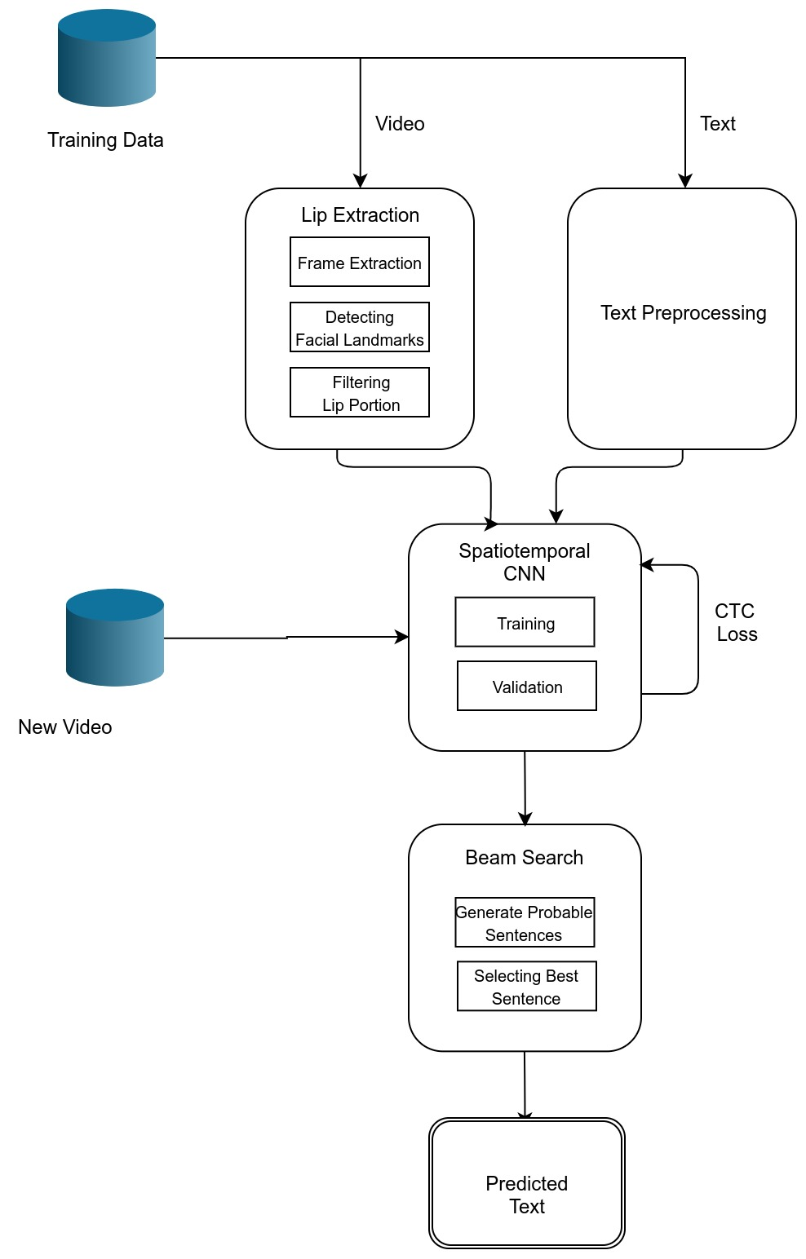

Slide 11
DETAILED MODULE DESIGN
Module design consists of four modules:
Lip Extraction
Text Preprocessing
Spatiotemporal CNN
Beam Search

Slide 12
LIP EXTRACTION
This module first loads the video frame-by-frame. At each frames, the following actions are done. First, the face is detected by a detector that using HOG. Then facial landmarks are detected that estimates co-ordinates of facial region in the image. Here only lip portion is cropped and saved to the folder created for each video.
INPUT: Video
OUPUT: Lip portions in each frame

Slide 13
ALGORITHM:
frames = framereader(path_to_video)
for each frame in frames
face = face_detector(frame)
landmarks = facial_landmark_predictors(face)
lip = landmarks[49:68]

Slide 14
TEXT PREPROCESSING
General operations like separating where we split strings of text into smaller pieces and joining tokens are performed. In this module, the “align” dataset is subjected to preprocessing steps like cleaning the data, removing punctuation and special characters and doing a spellcheck.
INPUT: Text Data
Output: Clean Text Data

Slide 15
ALGORITHM:
Clean data by removing special characters.
Remove fillers
Tokenize the text
Perform spelling correction
Untokenize the text

Slide 16
SPATIOTEMPORAL CNN
The training process of a CNN is done through an iterative algorithm that alternates between feedforward and back propagation passes of the data. The weights of the convolutional filters and fully-connected layers are updated at each iteration of the backpropagation passes. CNN is capable of learning classification features directly from the data. This module is proposed to extract features related to the traces left by different editing operations, and which are utilized to check the authenticity of images.
INPUT: Lips, Text
OUTPUT: Trained model

Slide 17
ALGORITHM:
Input of t frames is processed by 3 layers of STCC.
Then it is fed into spatial max-pooling layer.
Feature extraction is done by 2 Bi-GRUs where each time-step of the GRU output is processed by a linear layer and a softmax.
At last CTC loss is computed and proceeded to next batch of training.

Slide 18
BEAM SEARCH
Here we decode the prediction of the neural network by receiving its SoftMax probabilities. Beam search in general decides the number of words to keep in-memory at each step to permute the possibilities. Since we perform a non-greedy search, it iteratively creates many possible text candidates (beams). At each step, only the best scoring beams from the previous step are kept. At last, we select the best beam i.e. the probable text sequence.
INPUT: Neural Network prediction
OUTPUT: Predicted Sentence

Slide 19
ALGORITHM:
// NN output matrix mat, BW
Beams = {}, scores = {}
For each iteration do
bestBeams = bestBeams(beams,BW) //best of all previous beams
for b in bestbeams do
score(b) = calcScore(mat,b)
for w in words do
b’ = b+w
scores(b’) = calcScore(mat,b’)
beams = beams U b’

Slide 20
IMPLEMENTATION DETAILS AND RESULTS/SNAPSHOTS
The GRID corpus consists of 34 subjects, each narrating 1000 sentences.
All videos are 3 seconds long with a frame rate of 25fps.
The videos are processed with the DLib face detector, and the iBug face landmark predictor with 68.
Using these landmarks, we predict the lip portion to extract a mouth-centred crop of size 100 × 50 pixels per frame.

Slide 21
Detecting facial landmarks in an image is a two step process:
First we must localize a face(s) in an image. This can be accomplished using a number of different techniques, but normally involve either Haar cascades or HOG + Linear SVM detectors (but any approach that produces a bounding box around the face will suffice).
Apply the shape predictor, specifically a facial landmark detector, to obtain the (x, y)-coordinates of the face regions in the face ROI.

Slide 22
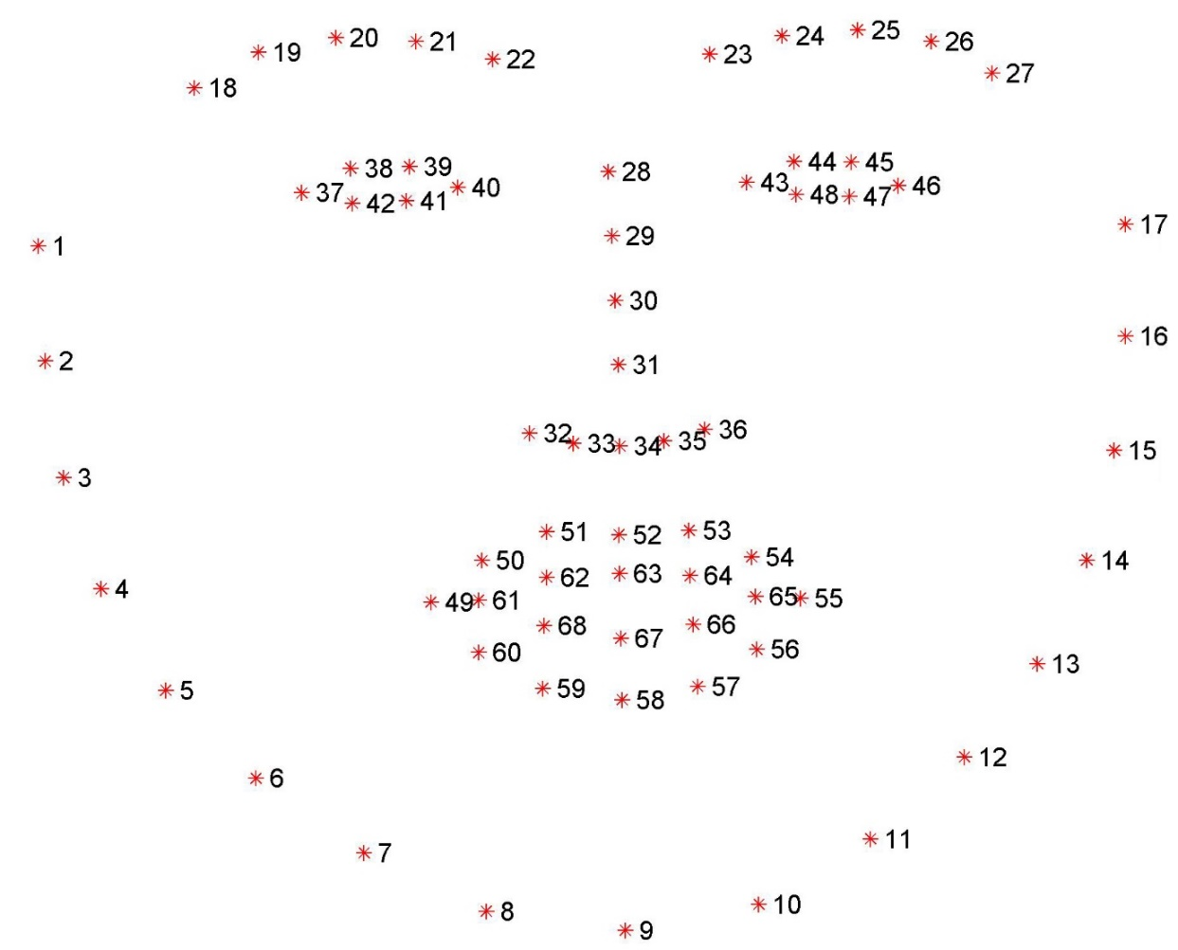

Slide 23
We load the video frame-by-frame. At each frames, the following actions are done.
the face is detected by a detector that using HOG
Then facial landmarks are detected that estimates co-ordinates of facial region in the image.
Lip portions are marked by point (49-68). So we select only those
We are extracting mouth because we can't consider only the lips. The mouth too contribute in lip reading.
The extracted image is saved to the folder created for each video.

Slide 24
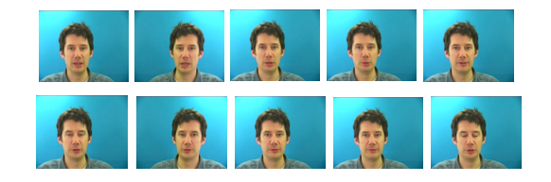
Get video frame by frame

Slide 25

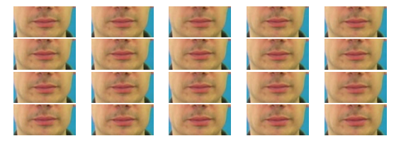
Filtering the Lip portion
Extracting the mouth portion

Slide 26
METRICS FOR EVALUATION
To measure the performance of Lip reading model, we compute the word error rate (WER) and the character error rate (CER), standard metrics for the performance of models.
We produce approximate maximum-probability predictions from model by performing CTC beam search.
WER (or CER) is defined as the minimum number of word (or character) insertions, substitutions, and deletions required to transform the prediction into the ground truth, divided by the number of words (or characters) in the ground truth.
Note that WER is usually equal to classification error when the predicted sentence has the same number of words as the ground truth, particularly in our case since almost all errors are substitution errors.

Slide 27
REFERENCES
[1] Assael, Yannis M, et al. "LipNet: End-to-End Sentence-level Lipreading." (2016).
[2] Goldschen, Alan J., O. N. Garcia, and E. D. Petajan. Continuous Automatic Speech Recognition by Lipreading. George Washington University, 1993.
[3] Youda Wei, Xiaodong Hu. "Text Recognition from Silent Lip Movement Video." (2018).
[4] Hassan Akbari, Himani Arora, Liangliang Cao, Nima Mesgarani. "LIP2AUDSPEC: SPEECH RECONSTRUCTION FROM SILENT LIP MOVEMENTS VIDEO." (2018)
[5] N. Rathee, "A novel approach for lip reading based on neural network," 2016 International Conference on Computational Techniques in Information and Communication Technologies
[6] Ahsan Adeel , Mandar Gogate, Amir Hussain, and William M. Whitmer. "Lip-Reading Driven Deep Learning Approach for Speech Enhancement." (2019)

